Slide 1
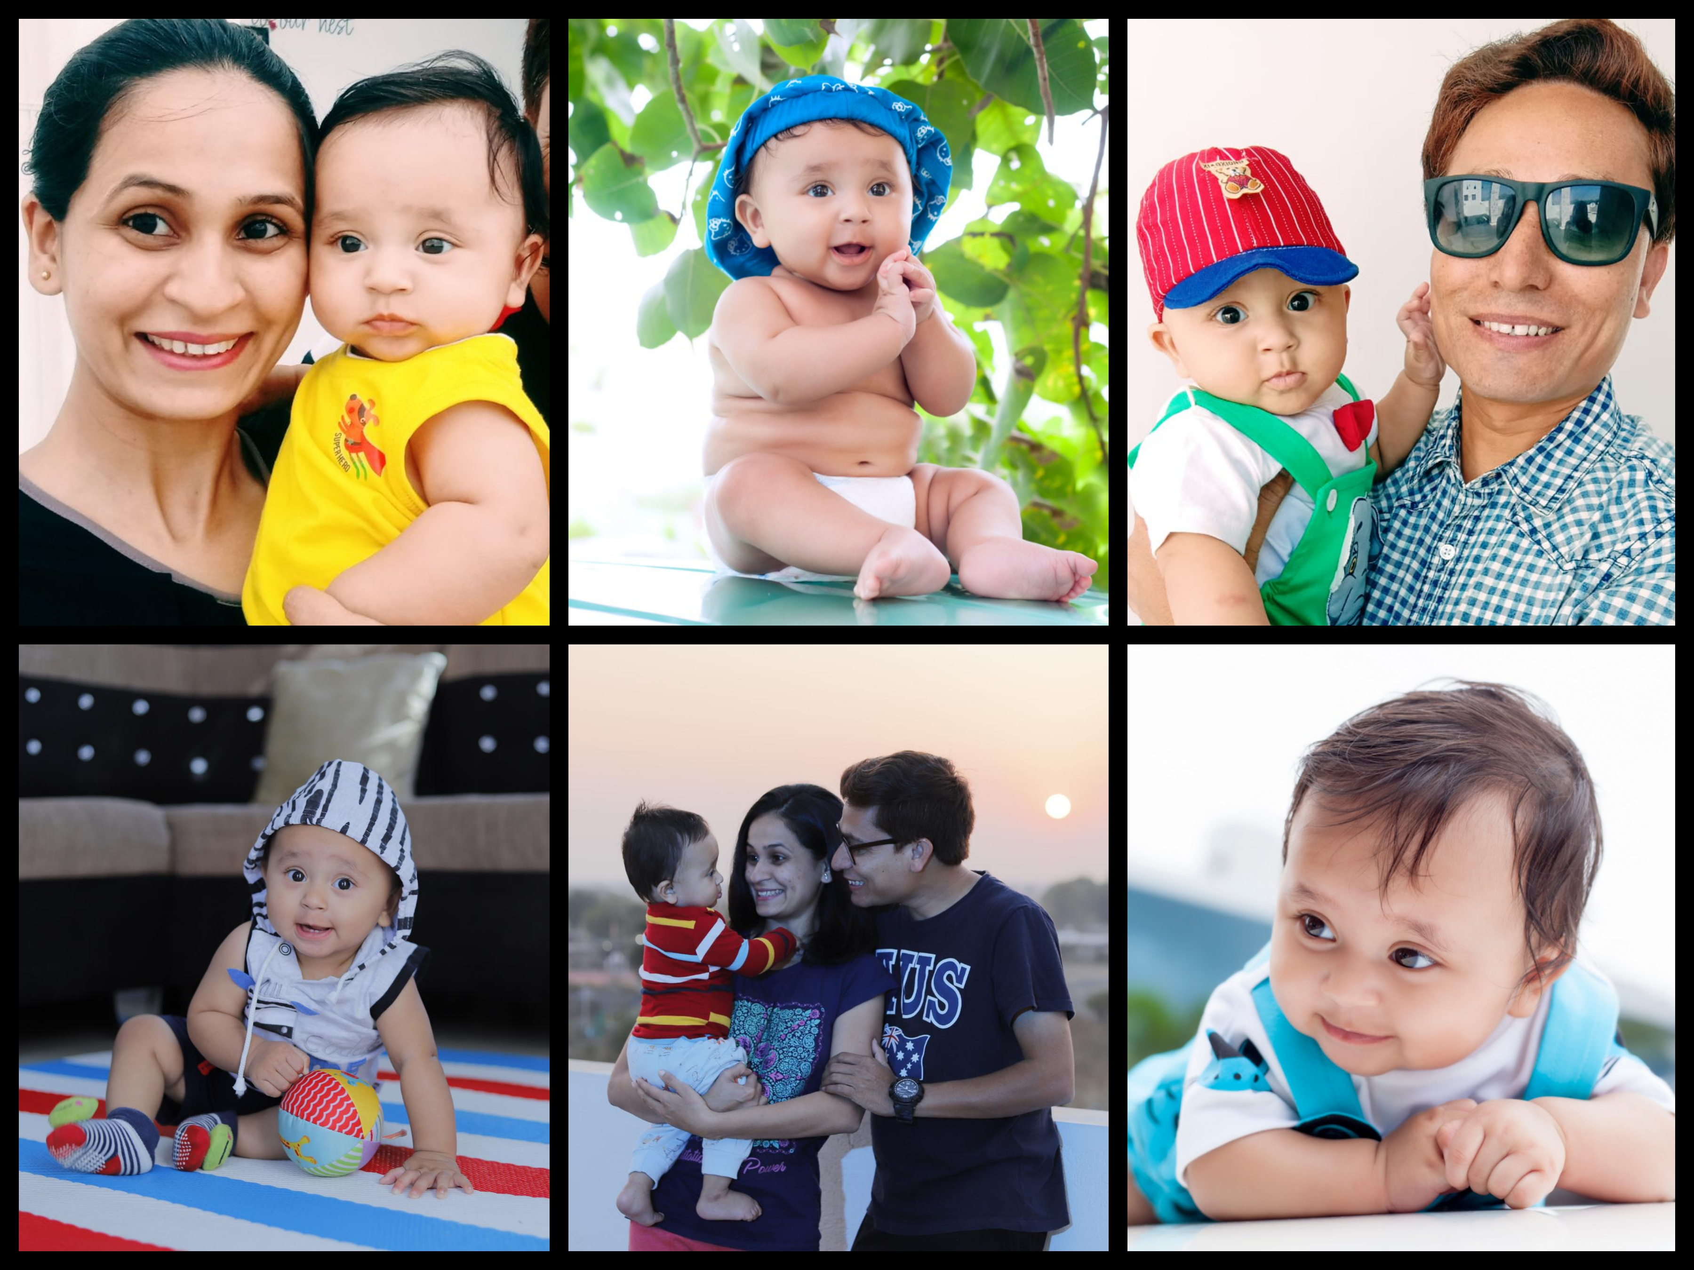
HAPPY BIRTHDAY SON
HAPPY BIRTHDAY TO YOU SON YOU'VE BROUGHT ME SO MUCH JOY WITH EVERY LITTLE THING YOU DO I'M GLAD THAT YOU'RE MY BOY
I STILL REMEMBER HAVING YOU ON THAT JOYOUS DAY THE TEARS I SHED OF HAPPINESS SAID MORE THAN I COULD SAY. I THANKED THE LORD FROM UP ABOVE FOR GIVING YOU TO ME THEN MADE A PLEDGE TO CARE FOR YOU TO
UTTERMOST DEGREE THROUGH THE YEARS YOU'VE BLESSEDME MUCH MORE THAN I CLOUD YOU I LOVE YOU SO , MY DEAR SWEET SON
MY PLEDGE I DO RENEW
HAPPY BIRTHDAY SON

